Slide 1
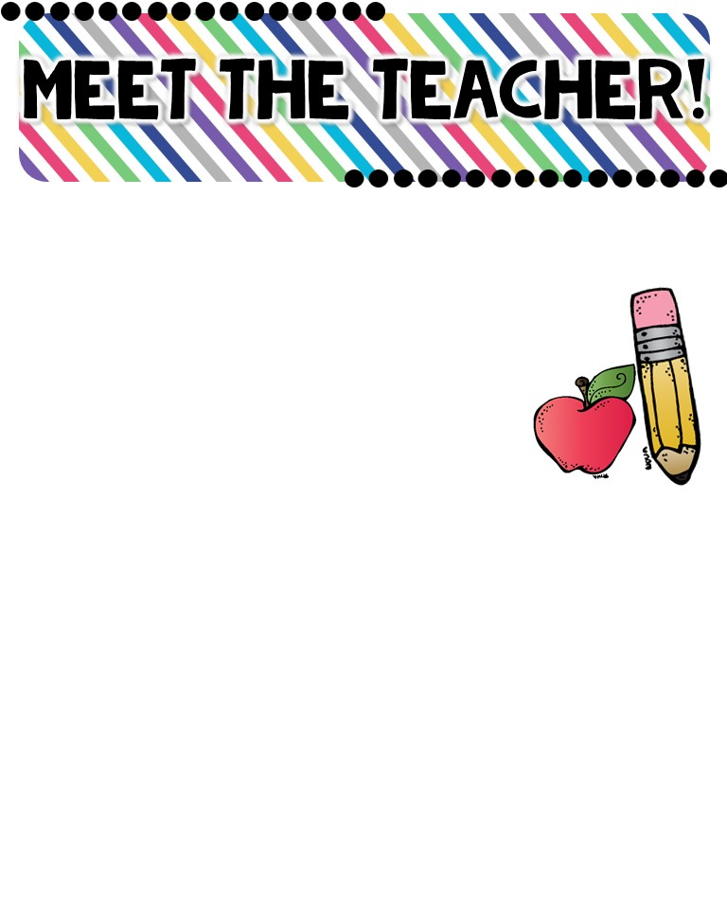
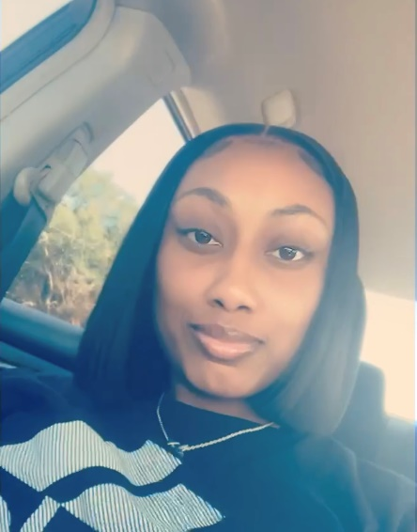
Ms. Key; First Grade
The Basics!
I am excited to embark on this new chapter in my life. This is my third year as a full-time educator. I am an advocate for student learning. As well as committed to creating a classroom environment where students are valued, loved, trusted, and an integral part of our family of learners.
About ME!
I am from Augusta, Georgia. I am an only child and a first time mommy of a baby boy named Jacob. I enjoy spending time with my baby , family, and friends! I am an Aquarius ☺ Birthday: Jan.31st
MY FAVORITES!
MY EDUCATION!
Food: ALL FOODS ☺
Color: Pink and Black
Drink: Water and Sprite
Season: Fall
Hobby: Shopping
I graduated from Savannah State University in 2017 with a B.S degree in Behavior Analysis. I am an Alumni of T.W.Josey High School c/o 2013!!

